Slide 1

Welcome to
SAPOE Members Meeting
and AGM
Tuesday 4th March 2025
Glasgow City Chambers
Notes:
Tutor add name to slide & background picture from GOT (title can be changed to Visit training/EVC as appropriate
Tutors can add there own organization logo in Slide design

Slide 2
Welcome!
Agenda
Domestics
10.00 – 10.10 Welcome and Apologies – Tim Pickering
10.10 – 11.10 SAPOE BUSINESS UPDATES
Matters arising from 10/12/2024 – Tim Pickering
Training Team update – Ali for Liz Brookes
GOT Update - Des Bagshaw
Officer Update – Ali Dreyer
NGB Reports and Questions – NGB reps
11.10-11.25 SAPOE Project Updates
11.25 - 11.45 Members Survey Review and Questions – AliD
11.45 - 12.15 SAPOE Strategy 2024-2029 Year 2 – TimP
12.15 - 12.30 AOB:
50 Yr Celebrations – TimP
Conference 2025 - ViksW
12.30 - 13.30 Lunch and networking opportunity. BYO lunch, café or local options
13.30 - 14.30 Guest - Rosie Goolden – Talk and Questions
14.30 - 15.30 AGM
Social drink and bite to eat locally.
Lunch
Drinks
Fire Drills
Phones!
Notes:
Venue could be = online platform, teams, zoom, etc or face to face
Each other – Could be breakout rooms if large cohort – introduce in pairs/groups and feedback
Breakout to rooms/ tables

Slide 3
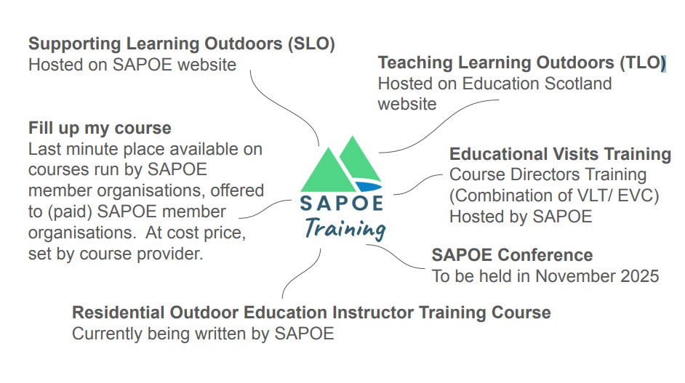
SAPOE Training

Slide 4
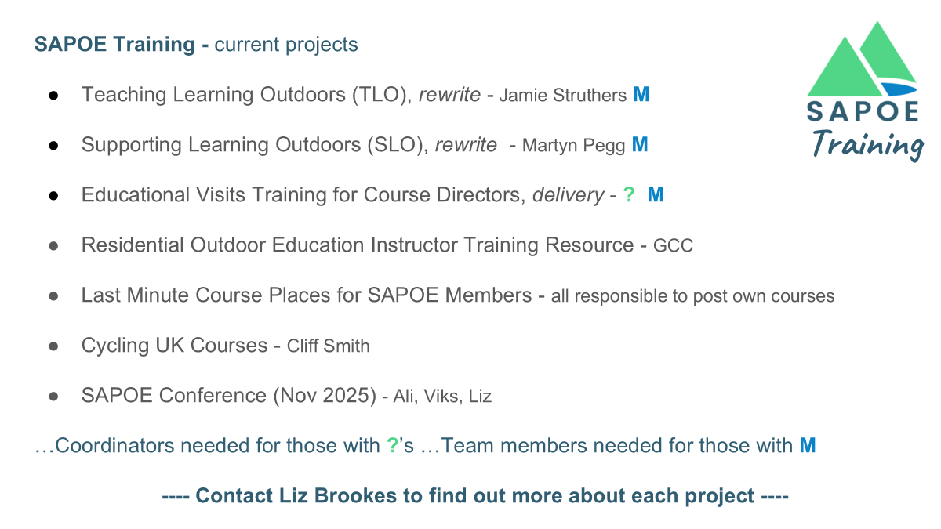
SAPOE Training

Slide 5
Lead Officer Update
Usual working days Monday & Tuesday
Communications checked most evenings
Main Duties
Member Communication & Meeting Admin
Collaboration; SG, ES, ADES, AHOEC & other organisations
Project Support e.g SOLSWG, CIC
SAPOE Working Group Support; GOT, Training
First 100 days and a bit more
Established new monthly newsletter
Attended project meetings
Oversight of website provider switch
Supported Arran Outdoors for All campaign
Members Survey
Annual Report – with support from Ida Maspero and Julie Young

Slide 6
SAPOE Projects
Scottish Outdoor Learning Strategic Working Group (SOLSWG)
A Scottish Government ministerial group tasked with providing a written briefing on outdoor learning for government ministers by May 2025. SAPOE is working alongside civil servants, AHOEC, Education Scotland, ADES and other partners.
SAPOE contacts Neil Wightwick & Ali Dreyer
Residential OE Instructors Training Resource
SAPOE is working with AHOEC and Education Scotland to produce a training resource, similar to the SLO and TLO courses and specifically aimed at instructors working in residential outdoor centres. The target date for the resource to be available is March 2025.
SAPOE contact Neil Wightwick

Slide 7
SAPOE Projects
Residential Outdoor Education High Quality document
SAPOE is working alongside AHOEC, Education Scotland and other partners to write a framework and supporting resources to effectively communicate expectations around residential experiences for Learners, Educators & Providers The document vis on schedule for the writing stage with funding secured for the next in-person review which is in the planning stages for early 2025.
SAPOE contacts Andrew Bradshaw & Ali Dreyer
Curriculum Improvement Cycle
SAPOE have a short-term working group to collate a response to this Education Scotland work and ensure outdoor learning is fully considered as part of this review cycle.
SAPOE contact Liz Brookes

Slide 8
SAPOE Members Survey
TOTAL MEMBER RESPONSES 26
Local Authorities | 23 | 20 Distinct LA’s (62%) | 2 Trusts represented
SCIS | 2
Other | 1 | Honorary Member
No return from LA | 12 (38%) | 5 LA’s have no rep | 1 LA has opted out | 6 Trusts represented

Slide 9
SAPOE Members Survey
SAPOE Current Communication – Please rate how useful you find each means of communication. From 1 not that useful to 5 very useful.
 | % rated 1 & 2 | % rated 4 & 5 | Exec Recommendations
Attending quarterly meetings in person | 15 | 59
Attending quarterly meetings online | 4 | 74 | Online slightly favoured over in person. Current plan is 2 in-person and 2 online meetings annually. Consider 3 online and 1 in person (conference).
Quarterly Meeting Minutes | 7 | 67 | Continue to circulate and store minutes on the website.
WhatsApp SAPOE Updates | 7 | 70 | Aim to increase users on the WhatsApp SAPOE Updates group
WhatsApp Biweekly Exec Updates | 7 | 63 | Continue with this immediately following each fortnightly exec meeting.
SAPOE Website | 30 | 44 | Ensure website is clean, up to date and efficient for its basic purposes. Make more use of storing and sharing files for members and training offerings.
Chairs Email Updates | 15 | 63 | Continue as and when required.
X | 78 | 7 | Consider removing our presence from X. Explore Bluesky and Linked In as alternatives.
Monthly Newsletter (New) | 7 | 78 | Encouraging response after the first two issues
Weekly Email | 26 | 40 | Not required. Move to fortnightly. Email template and newsletter in similar style.
2 day Annual Conference | 15 | 63 | Encouraging response to press ahead with conference planning for November 2025.
Annual Report – Planned for 2025 | 0 | 81 | NEED to do this well. Prioritise for March AGM. In progress.

Slide 10
SAPOE Members Survey
48% of responders willing to join a working group
Of these 20% GOT group, 20% Training group and 8% Membership and Communications group
16% of responders willing to join a short term project group
36% of responders were unable to commit.
Of these 33% already at capacity and 22% not part of core remit.

Slide 11

SAPOE Strategy 2024-29

Slide 12
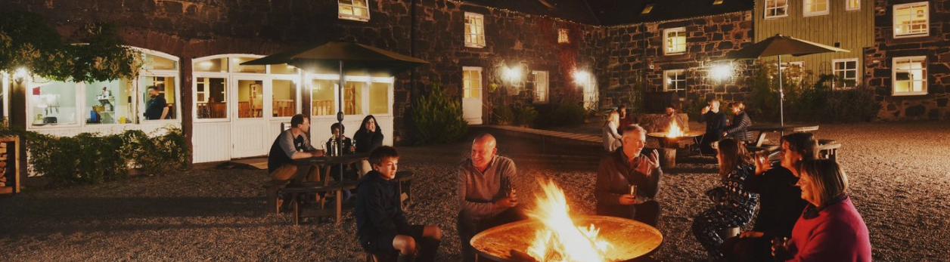
SAPOE, SCIS & Partners
Curriculum Beyond the Classroom Conference 2025
Date: 6pm Wed 12th – 1pm Fri 14th Nov 2025
Cost: £195 per person.
Including 2 nights shared accommodation, meals, pick up from Perth, speakers, activity sessions and workshops.
Location: Comrie Croft

Slide 13
Welcome to
SAPOE AGM
Tuesday 4th March 2025
Glasgow City Chambers
Notes:
Tutor add name to slide & background picture from GOT (title can be changed to Visit training/EVC as appropriate
Tutors can add there own organization logo in Slide design

Slide 14
SAPOE Annual Report
& Chairs Report
Notes:
Tutor add name to slide & background picture from GOT (title can be changed to Visit training/EVC as appropriate
Tutors can add there own organization logo in Slide design

Slide 15
Our Mission
To connect and collaborate with partners to lead, develop and influence outdoor learning policy – for the benefit of all in Scotland.​

Slide 16
Membership
The Members survey showed you value SAPOE and the support it offers​
We provided a supporting statement to Arran Outdoor Education Centre in their fight for survival​
Members found the WhatApp groups useful and they remain active

Slide 17
Collaboration & Representation
SAPOE gave evidence to Scottish Government to Committee on the Residentials Bill​
Represented on the Cross-Party Groups for Outdoor Education and Learning for Sustainability​
Representation on various Scottish Government and Education Scotland Working Groups​
Representations to the UK and Scottish Sport Governing Bodies

Slide 18
Communication
The 2023 communication plan reviewed after members survey​
The newsletter was launched in November 2024​
The GOT and SAPOE websites were migrated to new servers to improve performance​
Our back-office function has been moved to Office 365 to make communication easier

Slide 19
Now and the Future
Scottish Outdoor Learning Strategic Working Group (SOLSWG)
Residential Outdoor Education High Quality document​
Curriculum Improvement Cycle​
Residential OE Instructors Training Resource​
The Future…..
Increase member engagement
Impact policy
Update training
Improve implementation

Slide 20
SAPOE Income £19205
SAPOE 24/25 |  |  | Current Balance | 22,096.03
Income
Memberships |  |  | Going out there
Stirling Council | 600 |  | SCOTTISH GOVERNMEN 12376 GOT claim 1 | 3744
WEST LOTHIAN LEISU PPY015182/215 | 600 |  | SCOTTISH GOVT Residentia Outdoor training | 2461.25
EDC - CREDITORS 1 24833 | 600
ABDNSHIRE COUNCIL 101651918 | 600 |  | Scot Gov Got Claim 2 3744 Still to come in
UNIV OF EDINBURGH 251321 | 600
CC CREDITORS AC 13204 | 600
LIVE ACTIVE LEISUR LIVE ACTIVE LEISUR | 600
GLASGOW CITY COUNC GCC 2306159788 K | 600
EAC CREDITOR PAYME 4115805 | 600
MIDLOTHIAN COUNCIL MIDLOTHIAN COUNCIL | 600
EDINBURGH COUNCIL 59067 | 1000
INVERCLYDE CREDITO | 600
CNES CREDITORS A/C 50458 | 600
FIFE COUNCIL-PAYAB | 600
SCOTTISH BORDERS C 2405135 /44 | 600
SHETLAND COUNCIL SHETLAND COUNCIL | 600
ELC LB CREDITORS E L COUNCIL | 600
MORAY COUNCIL A01903 | 600
FALKIRK COUN PL FALKIRK COUNCIL | 600
ORKNEY ISLANDS COU OIC CREDITORS | 600
SCOTTISH COUNCIL O SAPOE 2024 SCIS 300000001344624556 804121 10 02MAY24 15:08 | 600
 | 13000 |  | 9949.25 | 6205.25
Total Income | 19205.25 | 22949

Slide 21
SAPOE Expense £12468
Officer post | 9040.18
Conference costs | 998.75
SAPOE Wesites/ hosting | 2056.08
GOT website hosting | 717.38
Insurance | 295.8
Other | 77.64
Total Outgoing | 12468.45

Slide 22
SAPOE Partners
Scottish Government Saskia Kearns
Education Scotland Ian Menzies or Mairi Thompson, Mark Irwin
ADES Carrie Lindsay (Executive Officer)
HSE Frances Kelly
AHOEC Nick March
OEAP Richard Painter
SAAF Jane Campbell-Morrison
Sportscotland: Currently no contact waiting for response
Sportscotland: Glenmore Lodge National Training Centre: Shaun Roberts
Youthlink (TSOLG) Neil Baird
NNOL and LtL Matt Robinson
Inspiring Scotland - Thrive Outdoors
Mairi Ferris & Carolyn McFarlane
NatureScot Sharon Cunningham

Slide 23
Meeting Schedule
Wednesday 4th June Online
Tuesday 2nd September Online
Conference
Wed 12th – Fri 14th November Comrie Croft
AGM Tuesday 3rd March 2026 In-person venue tbc

