Slide 1
Embedding play in local strategic planning: the Place Standard Tool
National Play Strategy Conference - Playful Places: Making Scotland the Best Place to Play
18th November 2015
Rory Mitchell
Notes:
Remit for the presentation – Place Standard, in play context

Slide 2
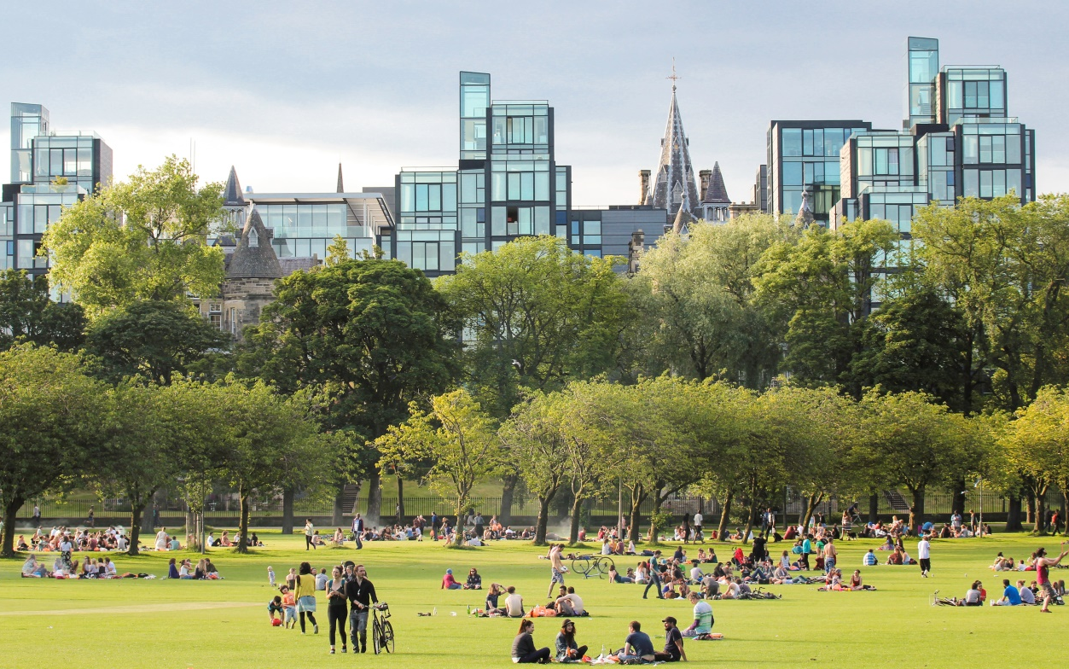
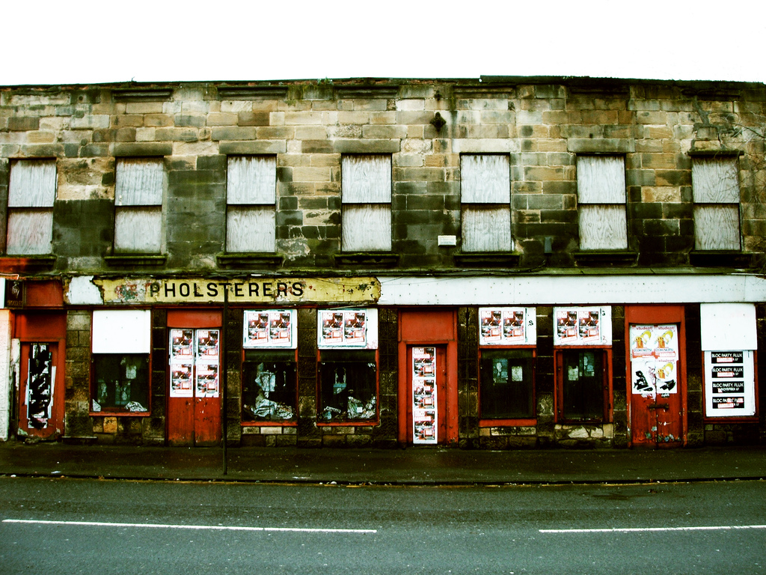
The environment that surrounds us has substantial influence over our health and wellbeing…
Image Flickr Lawrence OP
… and therefore over the inequalities in our society
Image Flickr Marcello

Slide 3
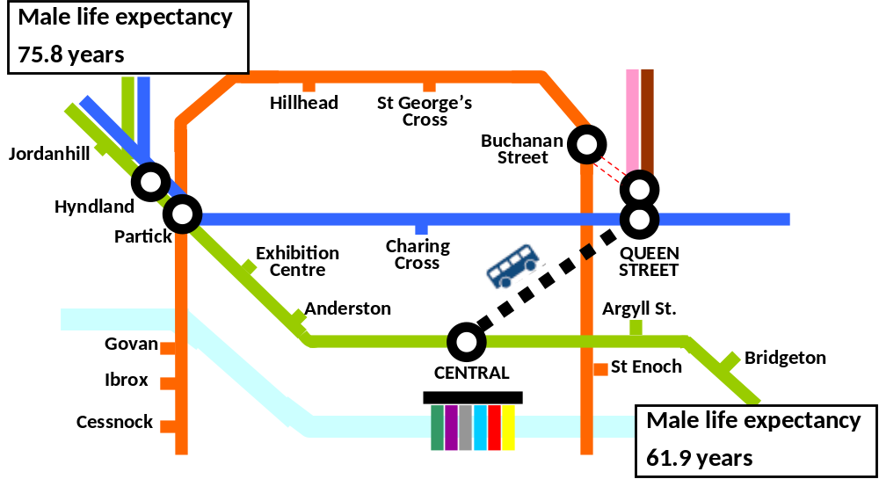
Health inequalities in Scotland
McCartney G. Illustrating Glasgow’s health inequalities. JECH 2010; doi 10.1136/jech.2010.120451 .

Slide 4
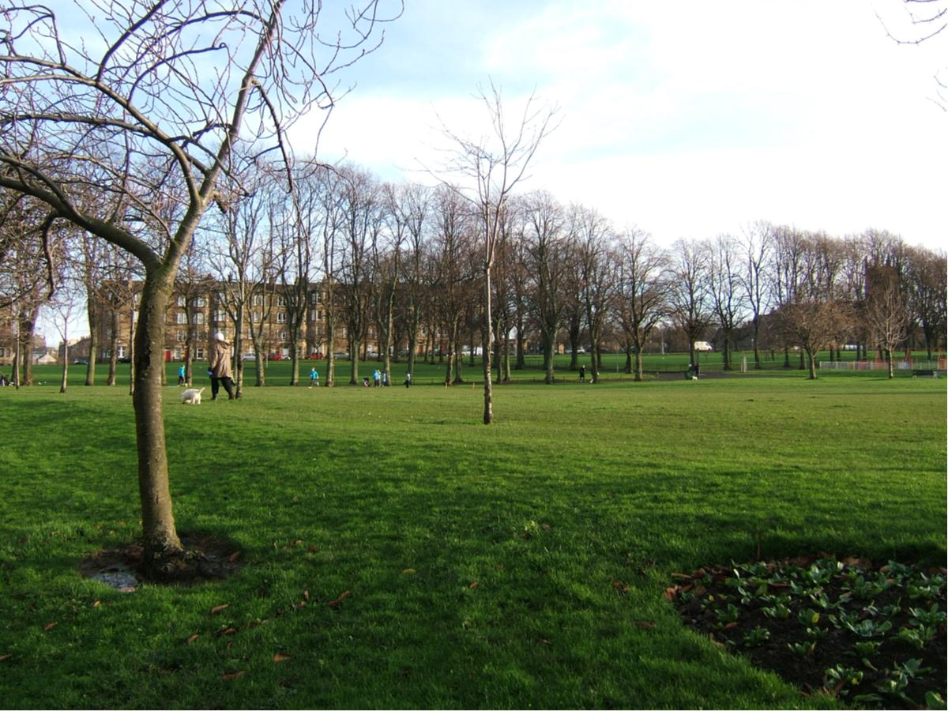
“Historically we have focused on creating environments free from significant hazards. Whilst this continues to be important we now recognise an additional need to create positive physical environments which nurture health and wellbeing.”
Good Places, Better Health Implementation Plan 2008

Slide 5
The vision
A Scotland where..
Children play, explore and relax outdoors in streets, parks, green places, open spaces, and have contact with nature in their everyday lives.
The presence of children outdoors is welcomed, supported and valued by parents, and the wider community.
Neighbourhoods are well maintained, safe, appealing… and have a strong sense of community.

Slide 6


The Place Standard Project
A Place Standard for Scotland
Partners:
Scottish Government (Architecture & Place)
NHS Health Scotland
Architecture & Design Scotland

Slide 7
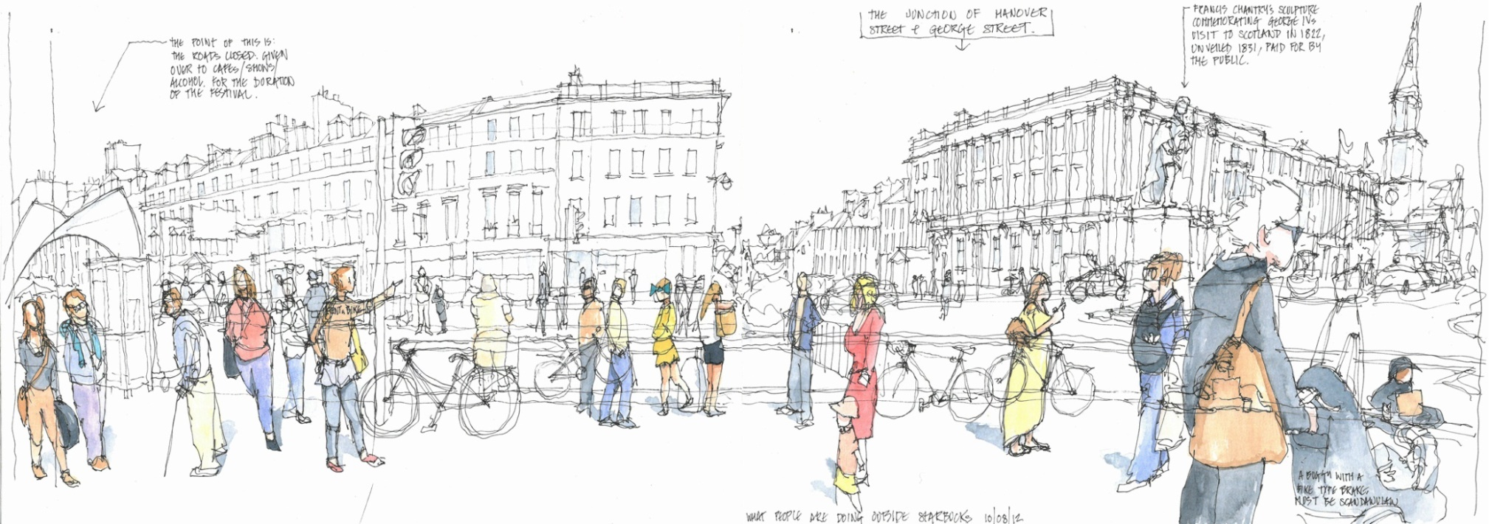
Place Standard Purpose…..
…to support the delivery of high quality places in Scotland and to maximise the potential of the physical and social environment in supporting health, wellbeing and a high quality of life.

Slide 8
What is it?
Notes:
… So what is it exactly?
At its core, the Place Standard is an assessment tool
It is intended to prompt and structure conversations about places (and how to improve them) within and between all those with a stake in that place. That includes public sector and prospective developers, but most importantly communities themselves. The 3rd sector are also crucial, often as a route to engaging communities.
Throughout, the Place Standard Tool is framed around the perspective of people: “what is it like to live here?”

Slide 9
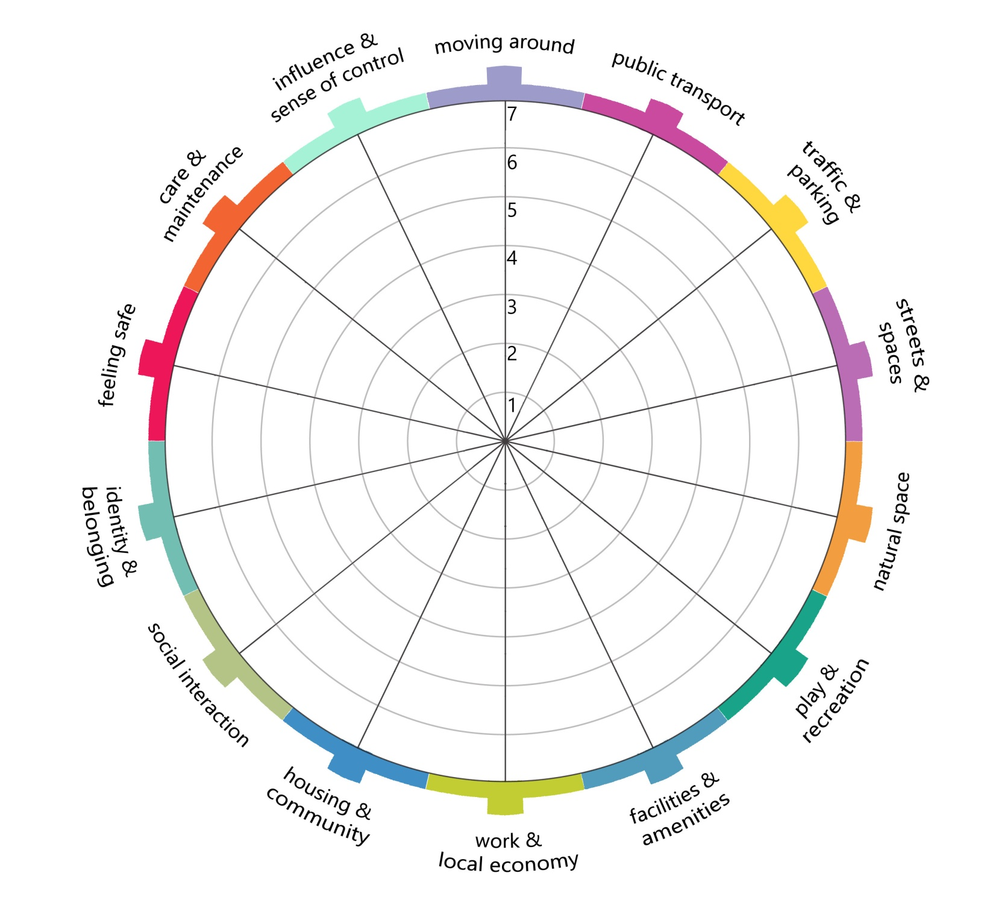

Slide 10
Can I easily walk and cycle around using good quality routes?

Slide 11
Do I have access to a range of spaces and opportunities for play and recreation?

Slide 12
Play & Recreation
You might want to think about ….
Are there opportunities and spaces for all to engage in play and recreation? You might want to think about some specific groups like teenagers, children with disabilities and older people.
Are there appropriate spaces and facilities to support play and recreational activities? Are these used to their full potential?
Are the available spaces and facilities of good quality and well maintained?
Are the available spaces and facilities accessible for all? And are they affordable to use?
Are children able to challenge themselves during play and build confidence through exposure to and experience of judging and managing risk? Is the presence of children playing outdoors welcomed by the community?
Do the available spaces and facilities feel safe to get to, be in and use? Is this affected by the time of day or year?
Next, rate your place on a scale from 1 to 7

Slide 13














Place Standard Tool – (Draft) Questions
can I easily walk and cycle around using good quality routes?
does public transport meet my needs?
do facilities and amenities meet my needs?
can I regularly experience good quality natural space?
do I have access to a range of spaces and opportunities for play and recreation?
does housing meet my needs and contribute to a positive environment for the whole community?
can I get on with my daily activities without impact from traffic and parked cars?
do buildings, streets and public spaces make getting around easy and enjoyable?
is there a positive identity and do I feel I belong?
do I have access to a range of spaces and opportunities to meet people?
do I feel able to participate in decisions and help change things for the better?
are buildings and spaces well cared for?
do I feel safe?
is there an active local economy and opportunity to access good quality work?
Notes:
Before going further it is worth considering the questions for the other 13 themes:
All – to a greater of lesser extent – are relevant to play. For example:
Natural Spaces makes reference to the value of contact with nature for all age groups
Streets & Spaces talks about the need for people to have priority over cars
Social Interaction emphasises the importance of a vibrant social element to a community, supported by the physical infrastructure
Perceptions of Safety is key – if parents and carers don’t feel a place is safe, children are unlikely to use that place or have much freedom there
Also – there is a lot of common ground when considering the needs of different age groups

Slide 14
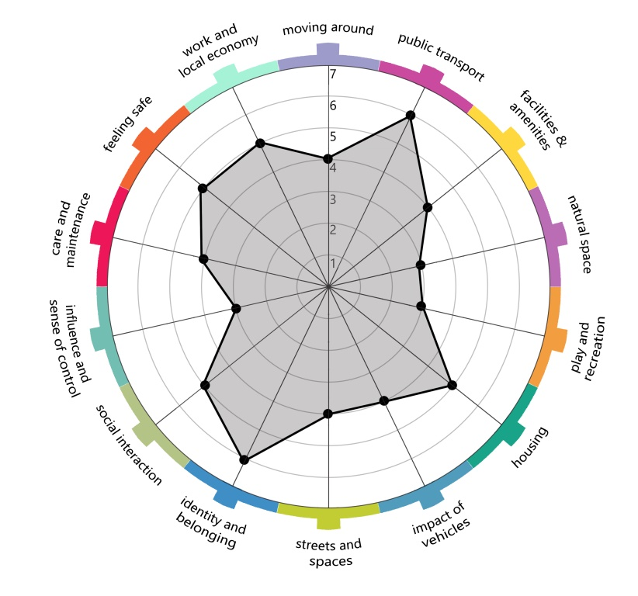
Notes:
The 1-7 rating is applied to each question and recoded on the compass – giving a simple, subjective, visual assessment of a place, that shows:
Strengths
Weaknesses
Priorities

Slide 15
Who is it for?
Notes:
Key user groups: public sector, private sector, 3rd sector, communities
This sets out the considerable ambition of the Place Standard: it should work for a range of users across a range of scenarios
By doing so it should help these user groups to work together and speak the same language

Slide 16
Which places is it for?
Notes:
Existing places, new development + areas undergoing regeneration
A variety of scales, though often neighbourhood is the focus
Urban + rural

Slide 17
When is it used?

Slide 18
What’s happening next?
Launch!
10th December 2015
Implementation
Evaluation

Slide 19
The implementation challenge
A wide range of scenarios & a wide range of users
Requires buy-in across user groups
Requires integration with existing tools, processes and resources…
Case studies and shared learning are key

Slide 20
The inequalities challenge
The potential for using the Place Standard to tackle inequalities is there, but…
It needs to be used to benefit those living in areas of deprivation
Overall the impact of the Place Standard needs to be distributed in a way that reduces inequalities

Slide 21
Conclusions
The creation of high quality places has the potential to improve health and wellbeing and tackle inequalities
Play is a vital part of a holistic view of place, which is interwoven with all other themes and has an important influence on health inequalities
The Place Standard Tool provides a potentially valuable mechanism for achieving shared goals across a range of agendas
Implementation in a way that reduces inequalities is key to success

Slide 22
Acknowledgements and References
Thanks to the Place Standard Project Team:
Johnny Cadell, Jamie Combe, Lucie Giles, Kathleen Marshall, Megan MacPherson, Louise Rennick, Sandy Robinson
And to:
Eric Dawson, Sheila Beck, Matt Lowther, Diarmaid Lawlor
Key references:
  Good Places Better Health (http://www.scotland.gov.uk/Topics/Health/Healthy-Living/Good-Places-Better-Health )
  Creating Places (http://www.creatingplacesscotland.org/ )
Contact: rory.mitchell@nhs.net

