Slide 1
Google Analytics Data for
SAPOE website
Natalie Polack
11th September 2014

Slide 2
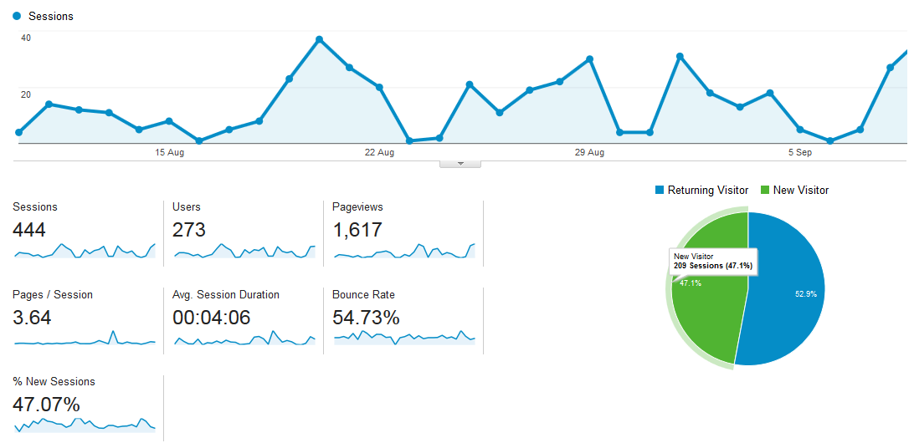
Data for last 30 days: 10th August – 9th September 2014

Slide 3
Definition of Terms
“Users” - number of people who have viewed the site
“Sessions” – this number is higher as it includes people viewing the site 2 or more times
“Pages / session” and “Average session duration” are good indicators of whether people are interacting with the site
  The numbers of 3.64 pages / session and session time of 4 mins 6 secs for the SAPOE website show that users are interacting with the website
“Bounce rate” – the % of people viewing 1 page then leaving the site
  There isn’t a correct answer as to what this should be
  Some experts say 45 – 65% is acceptable with 50% being a realistic target
    Need to look at data for individual pages
  Slide 7 shows more detail on entrance and exit pages for the site
    E-mails with links to News, Events and Vacancies result in a high number of single page views which affects average Bounce rate

Slide 4
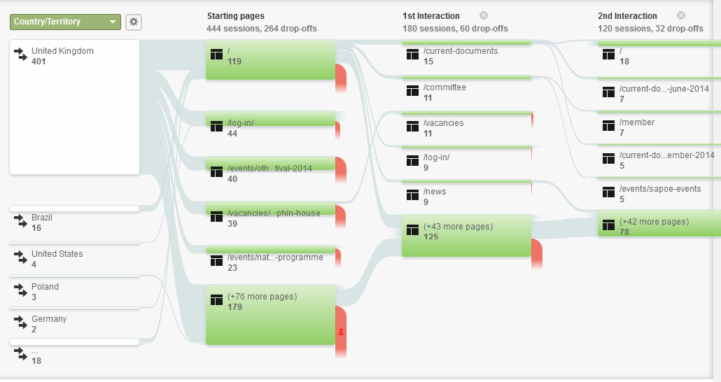
Users Flow
Last 30 days: 10th August – 9th September 2014

Slide 5
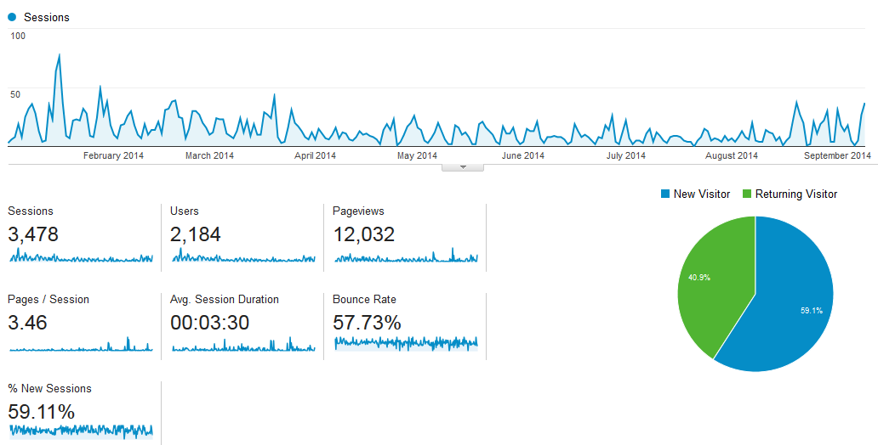
Data for 2014 to date: 1st January - 9th September 2014

Slide 6
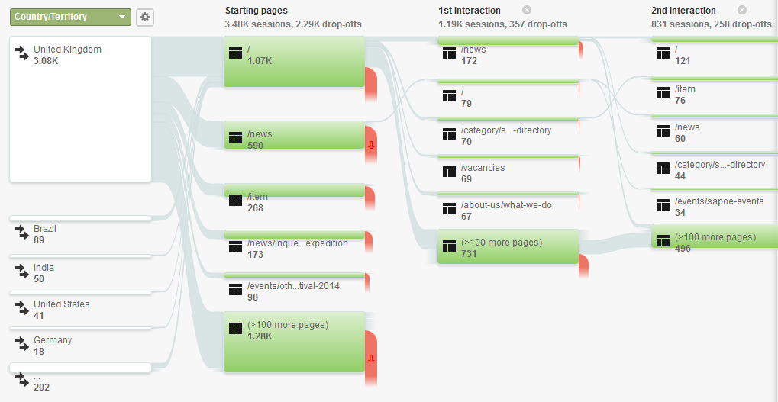
Users Flow
2014 to date: 1st January - 9th September 2014

Slide 7
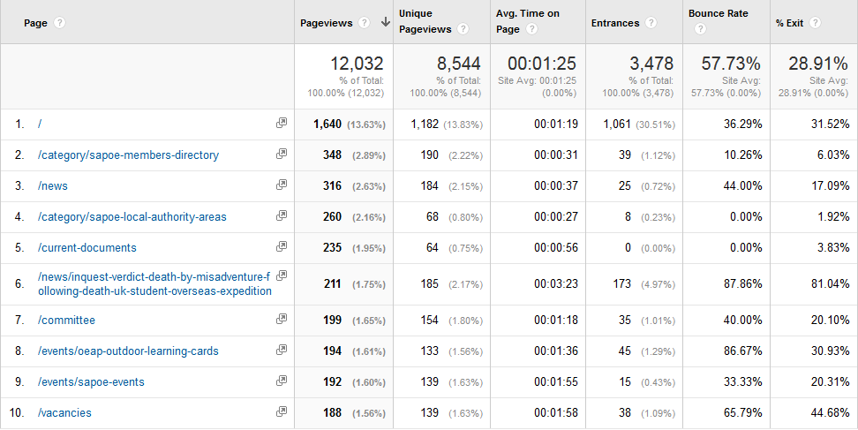
Top 10 pages for 2014 to date:
1st January - 9th September 2014

